Slide 1
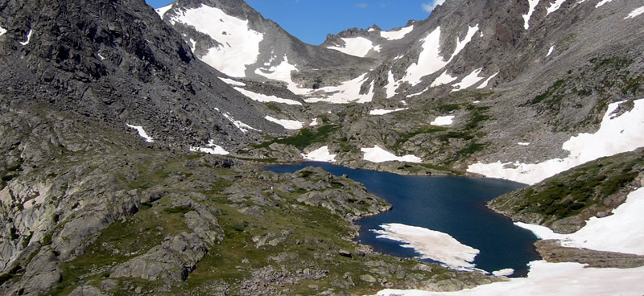
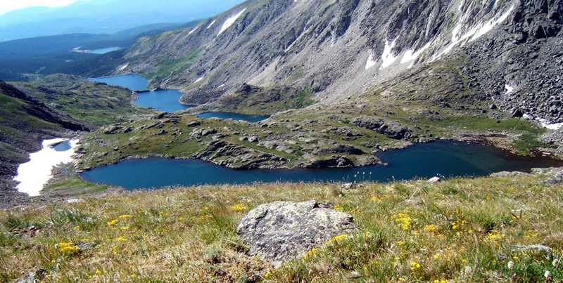
Niwot Lake Analyses
Matthew Green
Kurt Anderson
Morgan Brinkley
Raul Reza

Slide 2
Datasets
Ice Clearance
Zooplankton Species Composition Time Series
Water Quality and Chemistry Data
Functional Traits Data
Focused on ALB, GL1, GL4- Most Available Data!

Slide 3
Research Questions
How is Zooplankton community diversity structured among lakes?
What's driving patterns?
Environment? Space? Fish?
How are zooplankton communities structured through time (phenology)?
How are functional traits structured among lakes?
What's driving patterns? Environment? Space? Fish?

Slide 4
Zooplankton Diversity
Huge differences among GL4/5 and GL1/2/3/ALB
Sites explain 70% variation
Year explains 8%
DOY explains little

Slide 5
Environmental Variability
Environment and Diversity Ordinations don’t show similar patterns
GL1 most different-Connectivity and Position in Network

Slide 6
Ice Phenology

Slide 7
Ice Phenology

Slide 8
Ice Phenology

Slide 9
Zooplankton Phenology (Richness)

Slide 10
Zooplankton Phenology (Density)

Slide 11
Zooplankton Phenology (local diversity)

Slide 12
Functional Traits
Body Size Larger GL4 and GL5- Fish?
No strong trends for changes in body size throughout the year

Slide 13
Questions/Future Work
Missing Species Functional Traits Data (Body Size)
Publicly available data to fill in gaps
Functional Diversity Analyses
Benthic vs Pelagic organisms

Slide 14
Update 12/15/20

Slide 15
ENV Variability
Cleaned up location,depth
Added in water temp and chl data
PERMANOVA->
Among site differences explain 97% variation
Depth and year don’t explain much

Slide 16
ENV Variability
Just sites of interest for phenology
Same story with PERANOVA
Sites explain vairaition

Slide 17
Phenology
Absolute vs Relative time->days since ice off
Lake specific samples

Slide 18
Length of growing Season
Ice formation- Ice clearance= Growing season length

Slide 19
Length of growing Season

Slide 20
Scaling Clear and Formation dates
Subtracted ice clearance day and formation by minimum value for each lake

Slide 21
Biomass
Need rotifer data
Could do these analyses with just zoops with available data

Slide 22
TO do:
Scaling data
Zooplankton phenology
Biomass data analyses

